Slide 1

Elm Lunch Talk
eMarketer
November 28th, 2016
Bernard Wolff

Slide 2
What is Elm?
A functional programming language that compiles to Javascript/HTML and runs in the browser
A framework for building reactive web apps (think Knockout, React, Angular)
Inspired by Haskell (similar syntax)
Created in 2012 by Evan Czaplicki as his thesis. (https://www.seas.harvard.edu/sites/default/files/files/archived/Czaplicki.pdf)

Slide 3
Why Learn Elm?
“Learn at least one new language a year” – Pragmatic Programmer
“If you haven’t lost track of how many languages you’ve learned, you haven’t learned enough of them yet.”
FP renaissance, OOP disillusionment
Verbs vs. nouns (http://steve-yegge.blogspot.com/2006/03/execution-in-kingdom-of-nouns.html)
FP, why now? http://blog.salsitasoft.com/why-now/
New functional languages (Scala, F#, Clojure, PureScript)
FP concepts being introduced into mainstream languages
C# has LINQ
ES5+ has filter, map, reduce, etc.
Redux prior art (http://redux.js.org/docs/introduction/PriorArt.html)

Slide 4
Pros
Faster than React, Ember, Angular (http://elm-lang.org/blog/blazing-fast-html-round-two)
Easy to learn
great documentation
Slack support
user friendly error messages (think of compiler as an assistant rather than adversary)
easier syntax than other FP languages like Lisp, Haskell)
Gradual introduction is easy, and recommended (http://elm-lang.org/blog/how-to-use-elm-at-work)
Strongly typed / type safe (vs. JavaScript)
Interoperable with JavaScript via ports feature

Slide 5
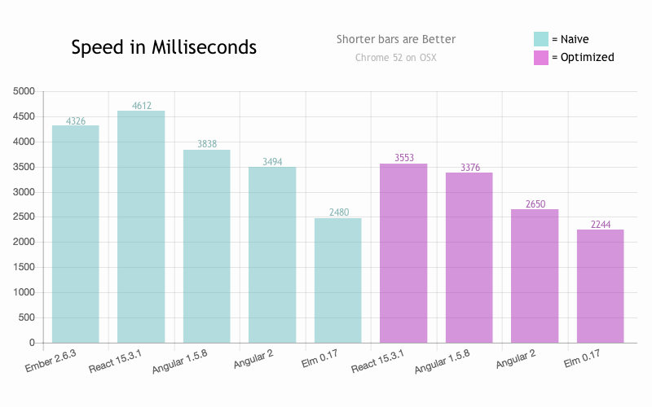

Slide 6
Cons
Unfamiliar syntax (if you’re used to C-style languages)
Smaller ecosystem of packages/users vs. JS
May not take off in the way the author predicts
Cannot be used on the server side (yet?)

Slide 7
Cool and/or Unique Features
Time traveling debugger
Immutability built in to the language (and by extension, pure functions)
Only differences are stored
No null or undefined (Maybe instead)
No runtime exceptions
Enforced semantic versioning (http://elm-lang.org/blog/announce/0.14
Hot swapping (not ready yet?)
Pattern matching, parameterized types
MVU
Currying (partially applied functions)

Slide 8
Live Demos
Mario http://debug.elm-lang.org/edit/Mario.elm (time traveling debugger)
Maybe (think nullable types in C#) https://github.com/bernardwolff/elm-presentation/blob/master/oneof.elm
Immutability https://github.com/bernardwolff/elm-presentation/blob/master/immutability.elm
Zip http://elm-lang.org/examples/zip (pattern matching)
Simple form http://elm-lang.org/examples/form (MVU architecture, html created with functions, type annotations)
Currying https://github.com/bernardwolff/elm-presentation/blob/master/currying.elm

Slide 9
Next Steps
More lunch talks?
Ideas:
Elm in depth
React, Redux, Immutable.js
PureScript
Something entirely different?
Start using Elm at eMarketer?
Further reading:
Collection of useful resourced for learning Elm: https://github.com/isRuslan/awesome-elm
Official Elm Docs (really good) http://elm-lang.org/docs
https://dennisreimann.de/articles/elm.html

